Slide 1

Sentiment Analysis of movie reviews

Slide 2
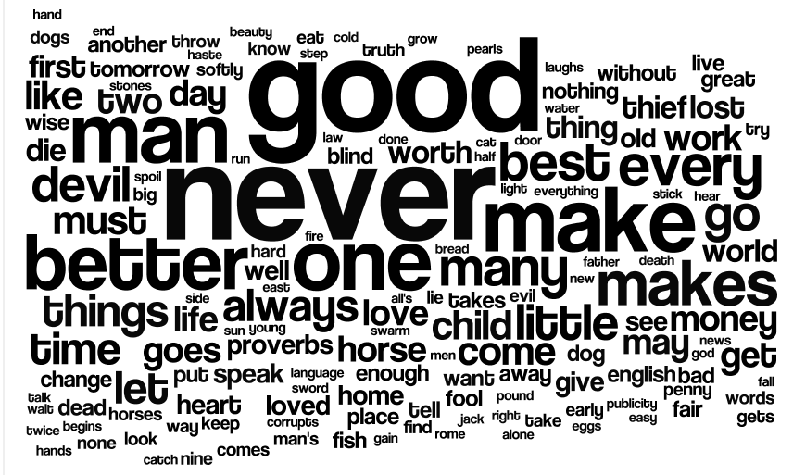
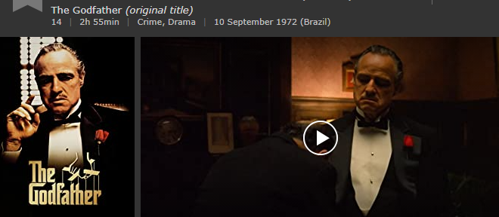
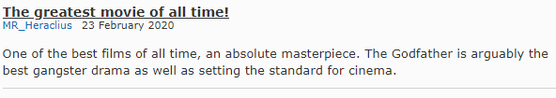
What is sentiment analysis?
Know as opinion mining or emotion AI.
Text analytics; the process of extracting high quality information from text.
Quantify, and study affective states and subjective information.
Is widely applied to the voice of customer as reviews and survey responses.
Applications from marketing to customer service.

Slide 3

Sentiment Analysis
Sentiment Analysis is the process of determining whether a piece of writing (product/movie review, tweet, etc.) is positive, negative or neutral. It can be used to identify the customer or follower's attitude towards a brand through the use of variables such as context, tone, emotion, etc.

Slide 4


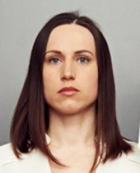


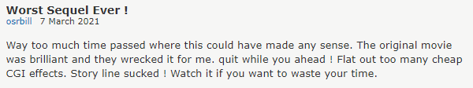
Review / Sentiment
How do companies analyse how customers think about the product or the company?
Is Where the company needs to perform sentiment analysis to know if the product is doing well in the market or not.

Slide 5

Why Sentiment Analysis?
Because we are talking about comments from people's feelings.
Companies can conduct market research and public opinion surveys. Their principal objective is to understand the experiences of their consumers and potential new customers.

Slide 6


Introduction to the project:
This notebook goes through a necessary step of any data analysis project - data cleaning. Data cleaning, is an important process. Feeding dirty data into a model will give us results that are meaningless.
What do we do?
Data processing.
Make text all lower case
Remove punctuation
Tokenize text: is the process of tokenizing or splitting a string, text into a list of tokens. One can think of token as parts like a word is a token in a sentence, and a sentence is a token in a paragraph
Remove stop words: are words which does not add much meaning to a sentence. (of, the, but)
Lemmatization: is the process of converting a word to its base form. ex: Playing, Plays, Played. common root form ‘play’.
BiGrams: is a sequence of two adjacent elements from a string of tokens.

Slide 7
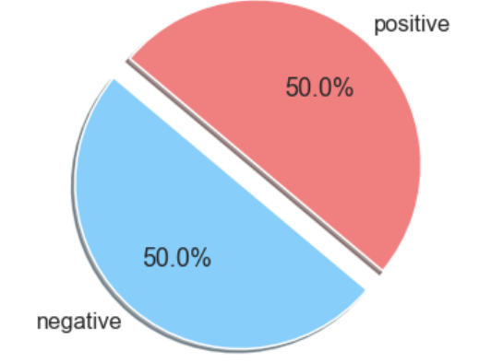
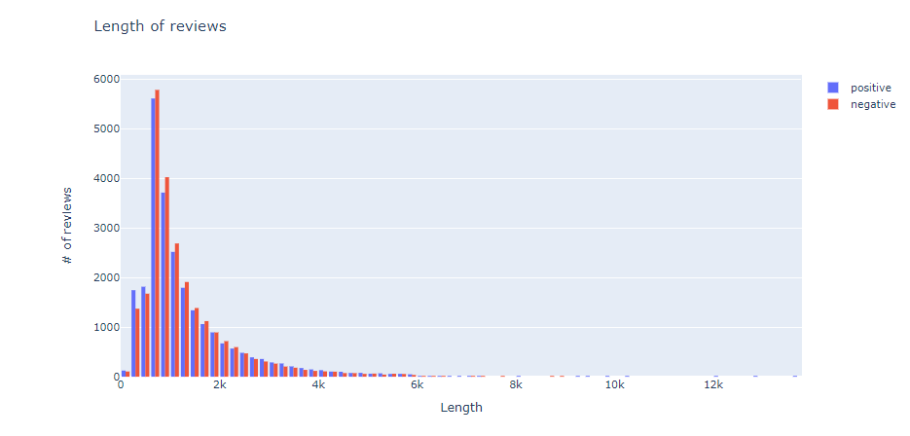
The dataset contains 25k positive and 25k negative reviews.
Here we observe that people tend to write more when the comment is negative.
The accuracy of the model comes out to 0.88 (88%). That means our comment classifier is doing a good job of identifying positives and negatives reviews.

Slide 8
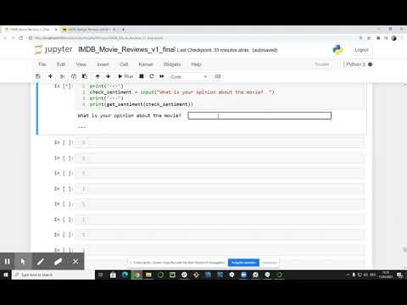
Let's see the test of the machine for new reviews.

Slide 9
Stay healthy!
Thank you!
Roberto Amaral
roberto.amaral@gmail.com

